Slide 1

Introduction to Cloud Computing & Microsoft Azure

Slide 2

Who are we?
Shreya D Panengaden
Microsoft Learn Student Ambassador
Android developer @DevCult
https://www.linkedin.com/in/shreyadenny/
Shreya D Panengaden
Microsoft Learn Student Ambassador
Android developer @DevCult
https://www.linkedin.com/in/shreyadenny/

Slide 3
AGENDA
What is Cloud Computing? (and why should you care?)
3 Service models of Cloud Computing
Types of Cloud Computing
What is Microsoft Azure ?

Slide 4


Slide 5
What is the Cloud?
Timesharing : sharing of a computing resource among many users at the same time
The cloud : refers to servers that are accessed over the Internet, and the software and databases that run on those servers.
Cloud Computing : on-demand availability of computer system resources, especially data storage and computing power, without direct active management by the user.

Slide 6
“Every kid coming out of school now thinks he can be the next Mark Zuckerberg, and with these new technologies like cloud computing, he actually has a shot.”
- Marc Andreessen, Co-founder of Netscape, Board Member of Facebook

Slide 7
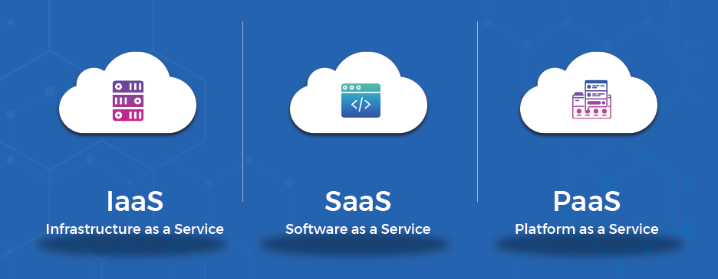
Service Models of Cloud

Slide 8
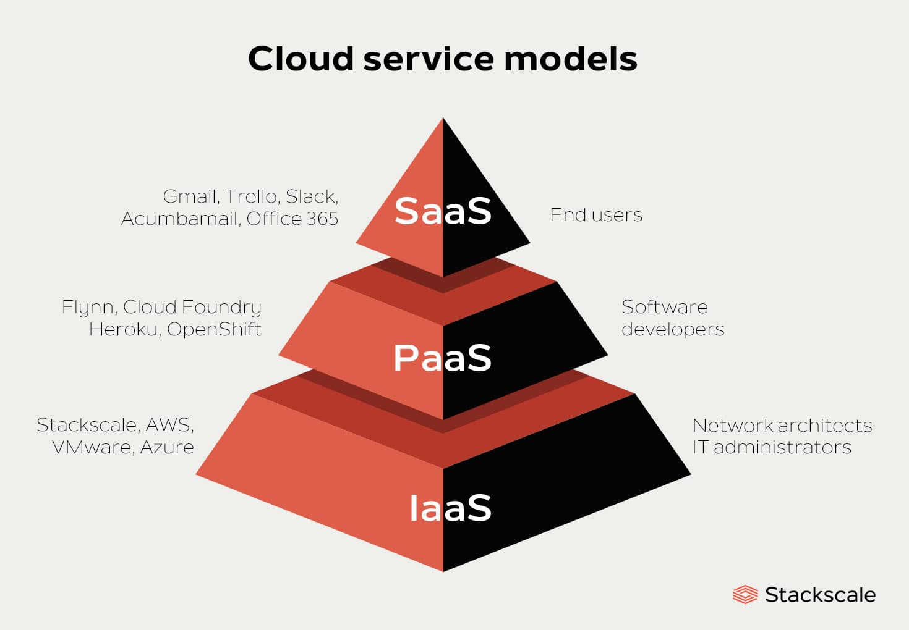

Slide 9
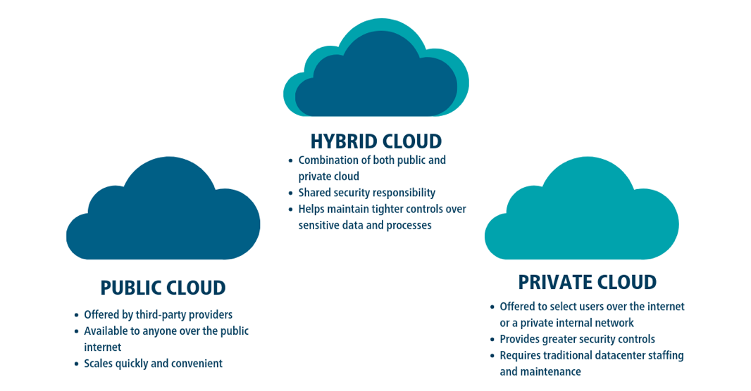

Slide 10
What is the Azure?
Cloud services that help your organization meet your current and future business challenges
It gives you the freedom to build, manage, and deploy applications on a massive global network using your favorite tools and frameworks.

Slide 11
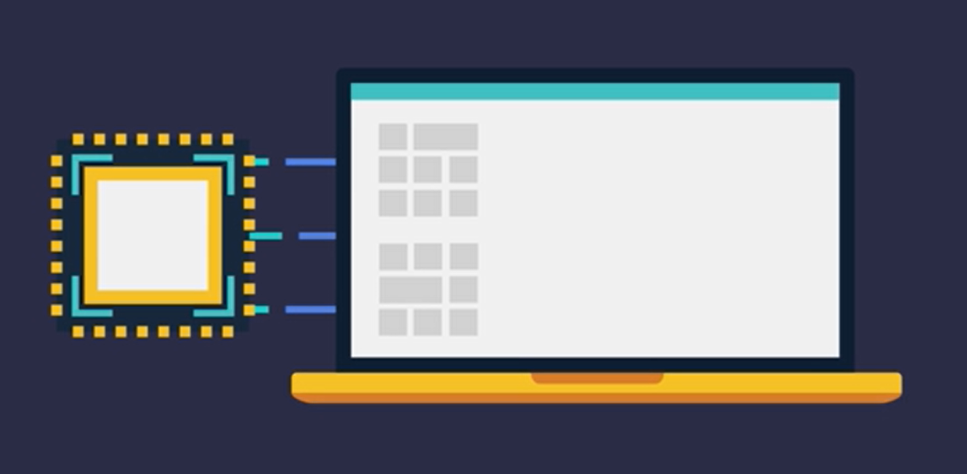
How does Azure work?

Slide 12
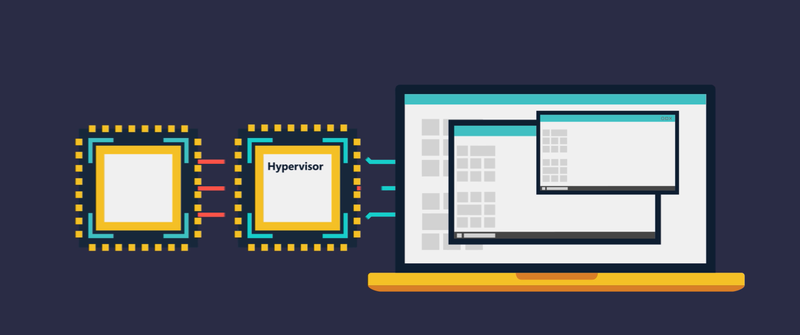

Slide 13
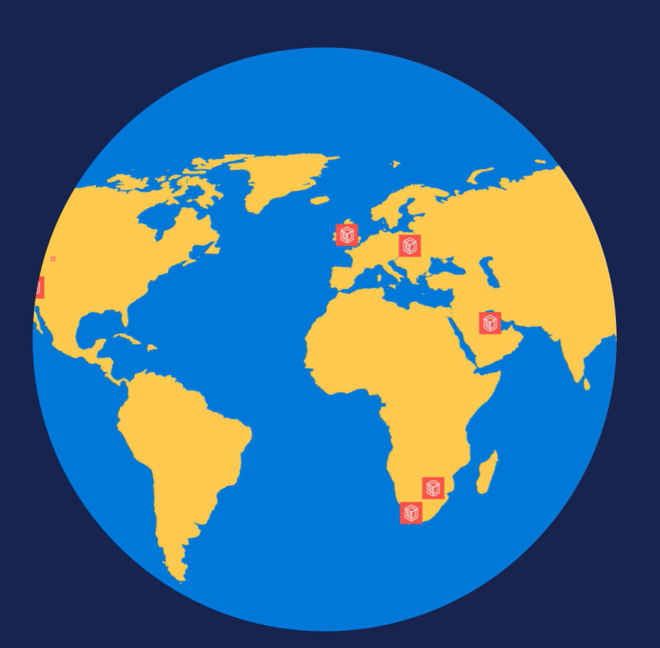
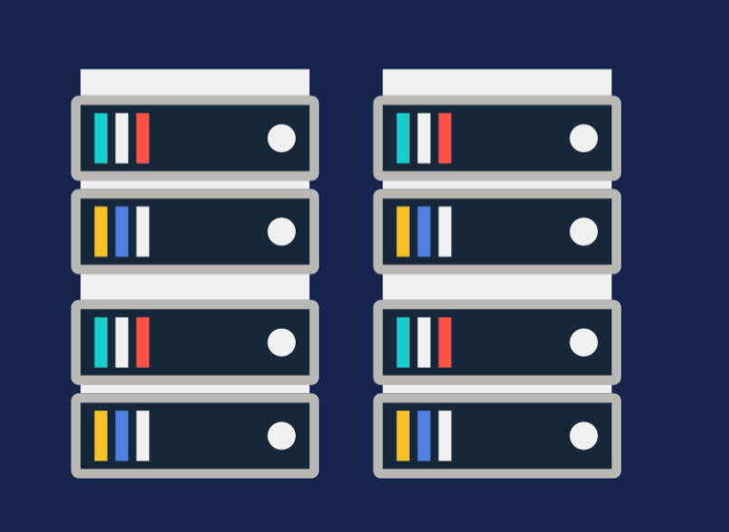

Slide 14
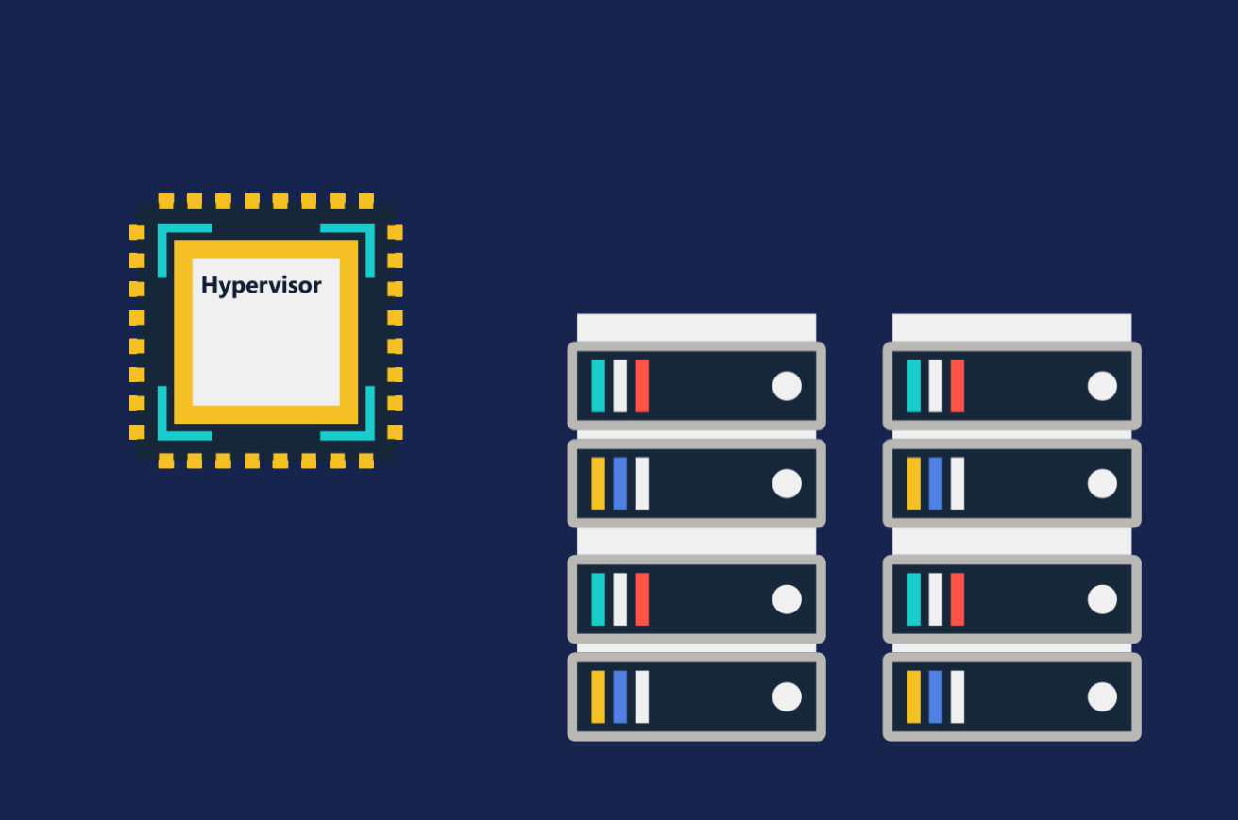
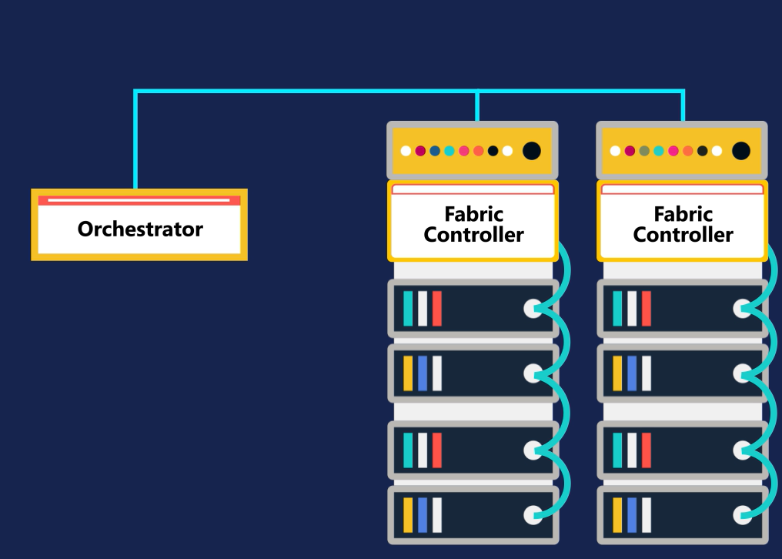
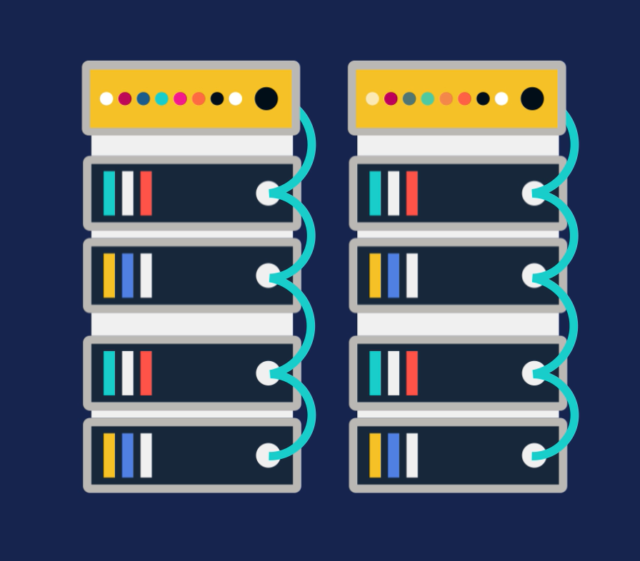

Slide 15
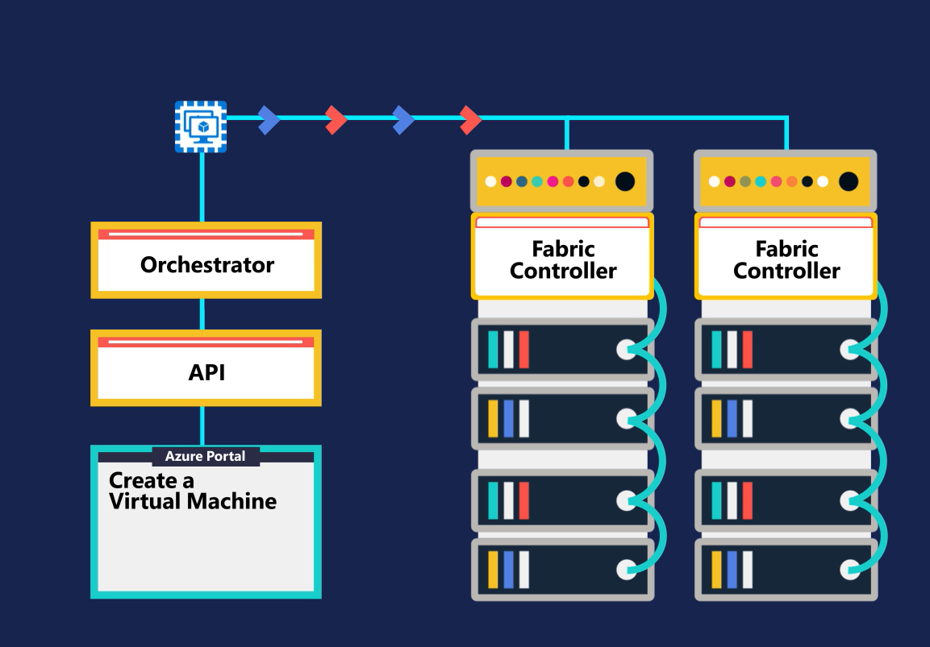
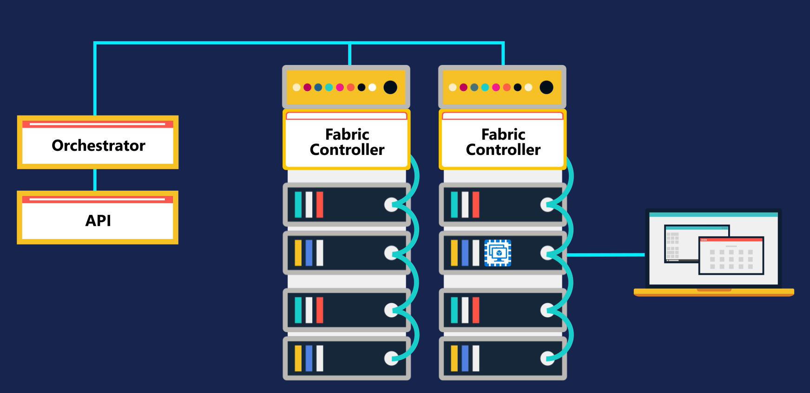

Slide 16
Thank You!

